Slide 1
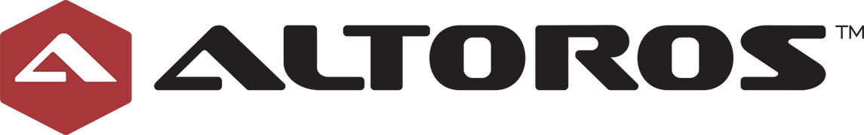
Cloud Foundry introduction

Slide 2
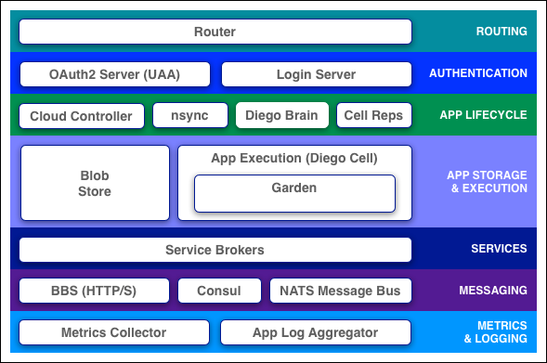
Components
Cloud Foundry components include a self-service application execution engine, an automation engine for application deployment and lifecycle management, and a scriptable command line interface (CLI), as well as integration with development tools to ease deployment processes. Cloud Foundry has an open architecture that includes a buildpack mechanism for adding frameworks, an application services interface, and a cloud provider interface.
Notes:
goal:
single platform for all devices
Increase quality and reduce the amount of stabilization
reduce planning.
PaaS is good fit for Project automatization
tests should be small.

Slide 3
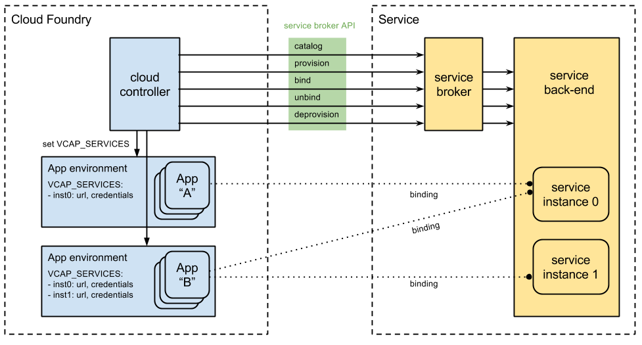
Service Broker
Notes:
goal:
single platform for all devices
Increase quality and reduce the amount of stabilization
reduce planning.
PaaS is good fit for Project automatization
tests should be small.

Slide 4
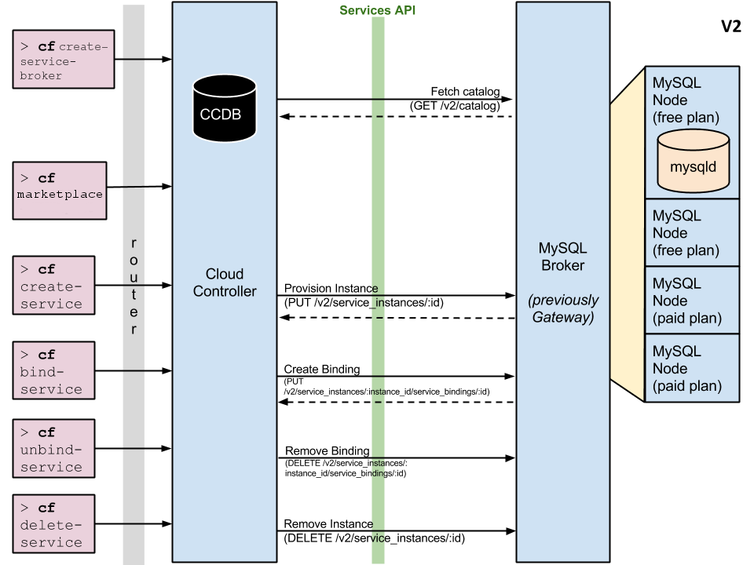

Slide 5
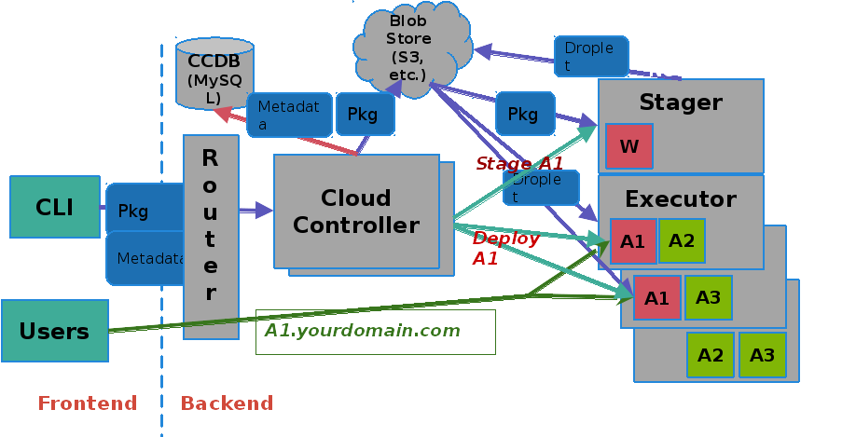
> cf push = deploy
Notes:
goal:
single platform for all devices
Increase quality and reduce the amount of stabilization
reduce planning.
PaaS is good fit for Project automatization
tests should be small.

Slide 6
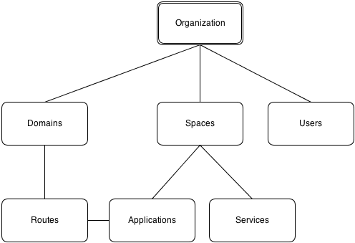
Orgs, Spaces, Quotas & Users
Organizations: An organization is the top-most meta object within the Cloud Foundry infrastructure.
Spaces: An organization can contain multiple spaces. The defaults for a standard Cloud Foundry install are development, test, and production.
Domains: A domain is a domain-name like acme.com or foo.net.
Routes: A route, based on a domain with an optional host as a prefix, may be associated with one or more applications.
Notes:
goal:
single platform for all devices
Increase quality and reduce the amount of stabilization
reduce planning.
PaaS is good fit for Project automatization
tests should be small.

